Slide 1


Digital control and processing of optical frequency combs for precision measurements
Jean-Daniel Deschênes, Hugo Bergeron;
Université Laval, Canada
Laura Sinclair, Ian R. Coddington, Nathan R. Newbury
NIST Boulder, USA
CLEO 2017, San Jose, May 18th, 2017

Slide 2
Talk outline
Digital control for combs
Why digital?
Available versions
Implementation
Features
Cycle slips in digital PLLs
Cycle slip probabilities
Effect of filter

Slide 3
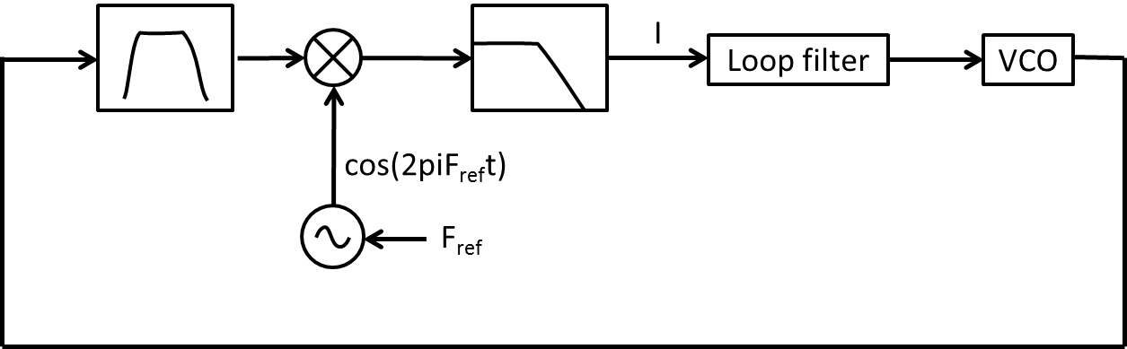
What do we mean by “digital PLL”
Analog PLL
Digital PLL for laser locking:
Laser
ADC
Demod
Loop filter
DAC
Laser
Digital processing
Replace as much electronics as possible by digital programmable hardware
DPLL platform consists of:
Hardware platform with ADCs, DACs, FPGA
DPLL Firmware running on FPGA
PC software with a GUI
All software is open-source & free
Hardware is a mix of COTS and open “schematics”

Slide 4
Why go digital?
Advantages
Flexibility
High integration possible
Phase extraction in difficult conditions
Replication is easier
Disadvantages
Latency can limit BW
Complexity
Mostly at design/conception, not replication!

Slide 5
Limitation of conventional analog phase detection
Microwave mixer used as phase detector
sin(Δφ) response: error Δφ must be < +/- π/2
y
Reference laser
y = sin(Δφ)
D1
LPF
Comb
Δφ
Feedback

Slide 6
Why digital control for combs?
Combs are clockwork for optical clocks
Combs need to be locked to their optical clock
Particularities:
low SNR
High carrier frequency
wide excursions possible
Locking only a difference frequency
lower requirements on lock and reference
For a clock:
No cycle slip!

Slide 7
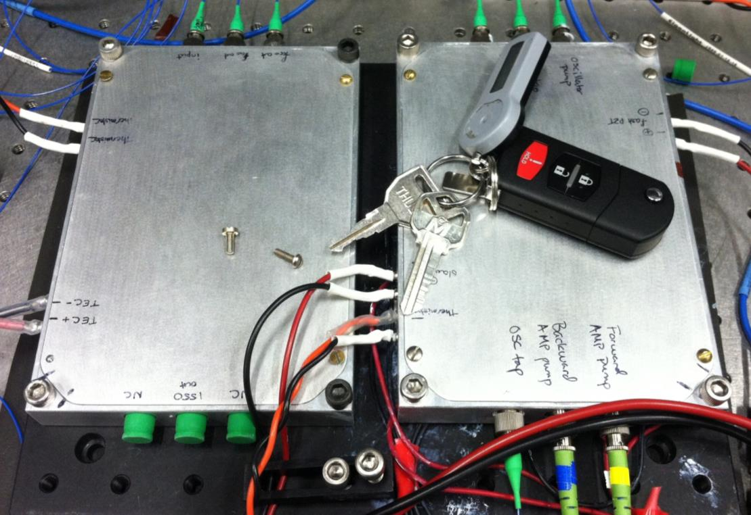
Fully self-referenced PM comb with digital locks
Optics package
Reference laser
0.7 Litre
D
HNLF
F_{b}
Comb
PPLN
D
F_{ceo}
PLL
PLL
Ref: Sinclair, L. C. et al. "Invited Article: A compact optically coherent fiber frequency comb." Review of Scientific Instruments 86.8 (2015): 081301.

Slide 8
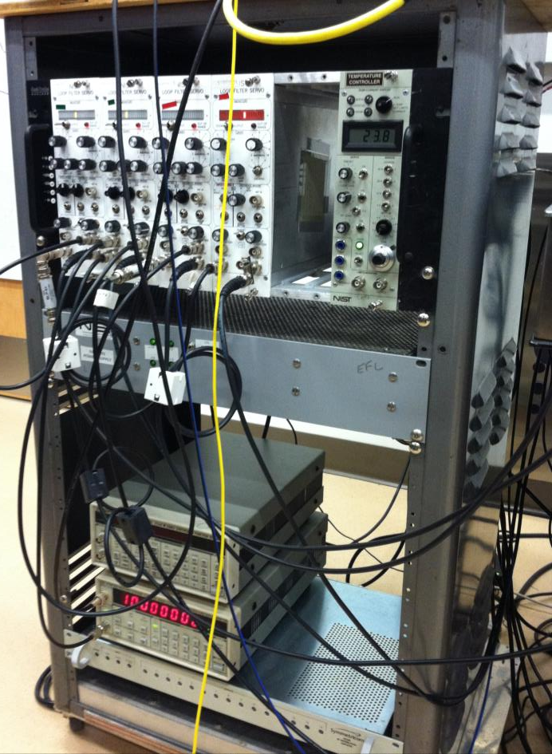
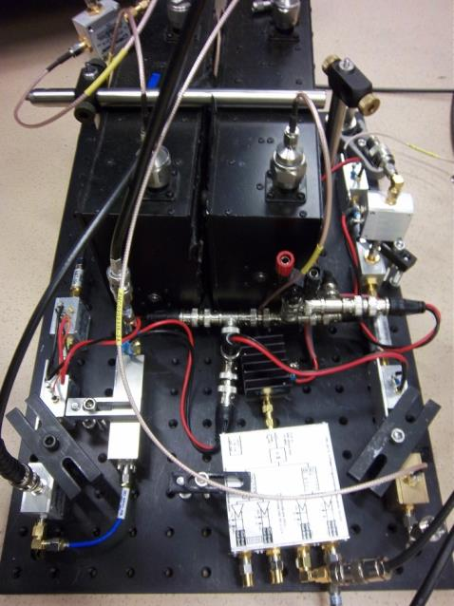
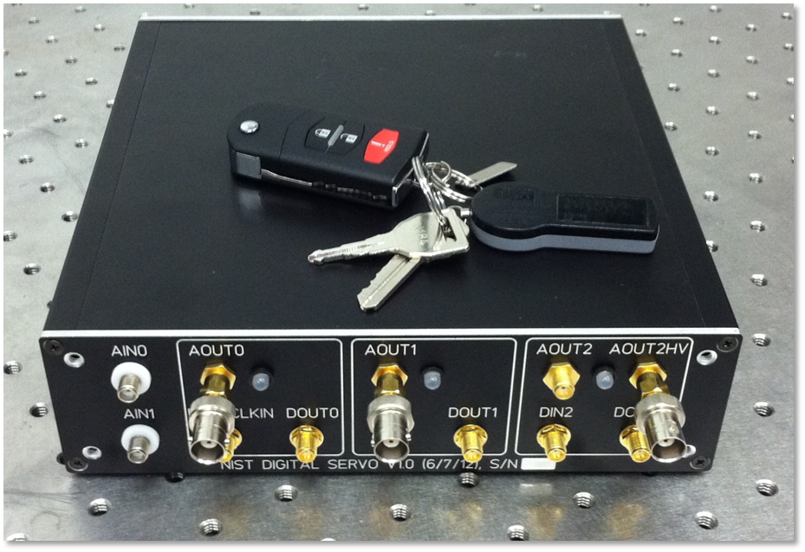
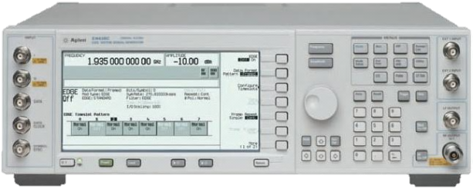
Fully self-referenced PM comb with digital locks
Optics package
Reference laser
0.7 Litre
D
HNLF
F_{b}
Peigne
PPLN
D
F_{ceo}
2.3 Litres
PLL
PLL
~200 Litres

Slide 9
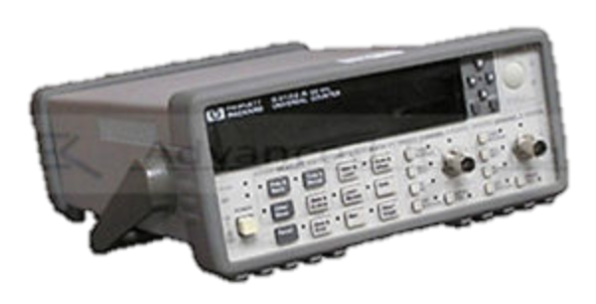
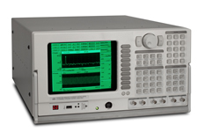
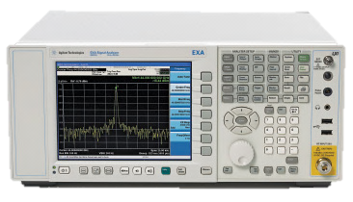
Fully self-referenced PM comb with digital locks
Optics package
Reference laser
0.7 Litre
D
HNLF
F_{b}
Peigne
PPLN
D
F_{ceo}
2.3 Litres
PLL
PLL

Slide 10
Features
2 Digital PLL:
IQ phase demodulation + unwrapping: tolerant to perturbations
PID loop filter
Built-in complete diagnostics:
On-line phase noise PSD
VNA
Zero dead-time frequency counters
Dither generator + lock-in
Clocked off comb itself: truly self-referenced
Factor ~100 reduction in volume

Slide 11
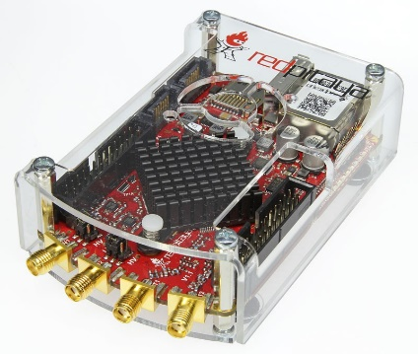
Two hardware platforms
New!
NIST Digital Lockbox
Red Pitaya
COTS FPGA board
+Open-source ADC/DAC board
>=2.5k$
USB2 interface
2x 14-bits ADCs @ 100 MS/s
3x DACs, 1 HV (55 V) output
2x 16-bits @ 100 MS/S
1x 24-bits @ 1 MS/s, HV (55V)
COTS ADC/DAC/FPGA
Cheap (~300$)
Ethernet interface
Runs Linux
2x 14-bits ADCs @ 125 MS/s
2x 14-bits DACs @ 125 MS/s

Slide 12
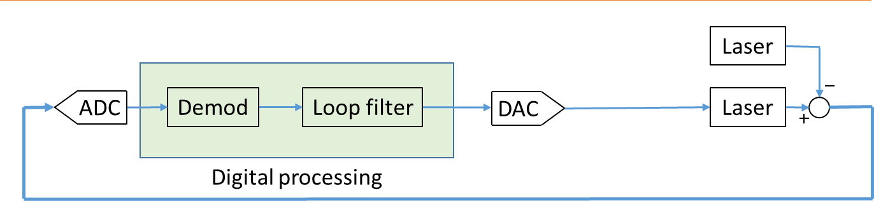
ADC noise & DAC noise
Quantization noise only: SNR = N*6 dB/bit + 1.76 dB
Time domain SNR = 10log₁₀(Signal Power/Noise power)
This noise is spread over the full Nyquist BW!
Spectral domain SNR = Time domain SNR + 10log₁₀(Fs/2/BW)
Example for Red Pitaya (14-bits ADC)
Still very high! ADCs are really good…
 | Time-domain SNR [dB]
Ideal 14-bits ADC | 86 dB
Red Pitaya’s ADC chip | 73 dB
Red Pitaya system | 63 dB
In 100 kHz @ 100 MS/s:
30 more dBs...

Slide 13
High-level block diagram
FPGA
PLL Channel 1
ADC
Demod
Loop filter
DAC
Lockin
2 independent DPLLs
+ Extensive diagnostics & logging to PC...
Freq counter
VNA
PLL Channel 2
ADC
DAC
(...)

Slide 14
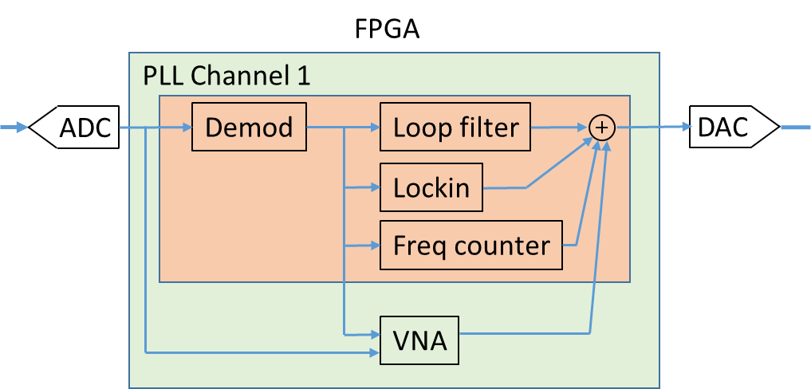
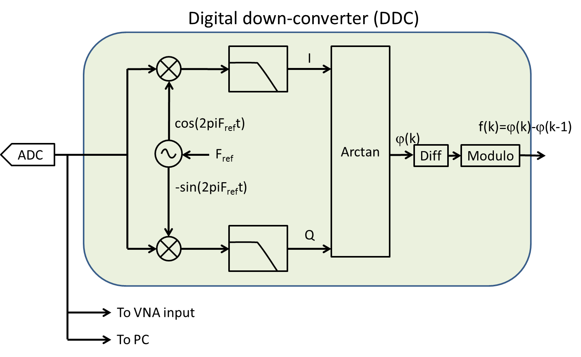
Phase/frequency demodulator
Phase unwrapping
Selectable low-pass filters (7 MHz, 30 MHz, 60 MHz)
Tunable reference frequency (0-60 MHz)

Slide 15
Phase/frequency demodulator: Phase extraction process
Frequency shift by -F_{ref}
Filter
Arctan(Q/I)
Unwrap
Spectrum
Im{}=Q
-f₀
+f₀
f₀-f_{ref}
Re{}=I

Slide 16
Phase/frequency demodulator: Phase unwrapping
Im{}=Q
Frequency shift by -F_{ref}
Filter
Arctan(Q/I)
Unwrap
Re{}=I
+π
-π
+π
-π

Slide 17
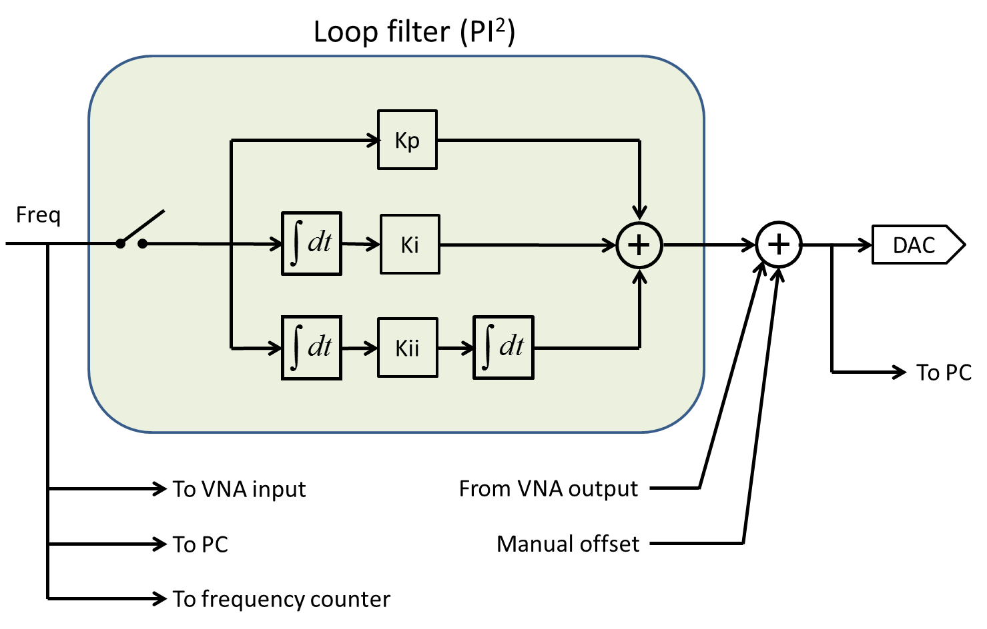
Loop filter
Proportionnal, Integral and double-integral branch
High noise rejection at low freq
Gain tuning through Bode diagram in UI

Slide 18
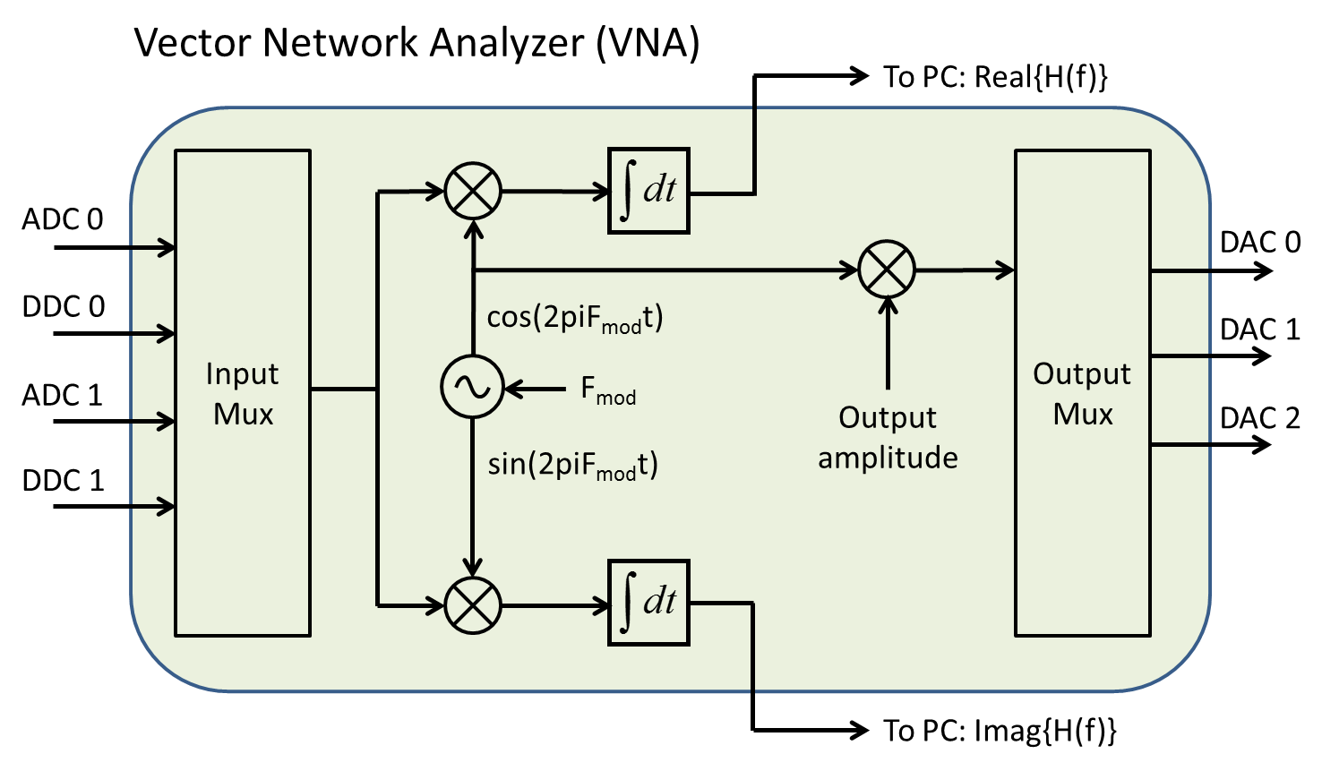
Feature: Vector Network Analyzer
Measures baseband OR FM transfer functions
Very useful for loop tuning

Slide 19
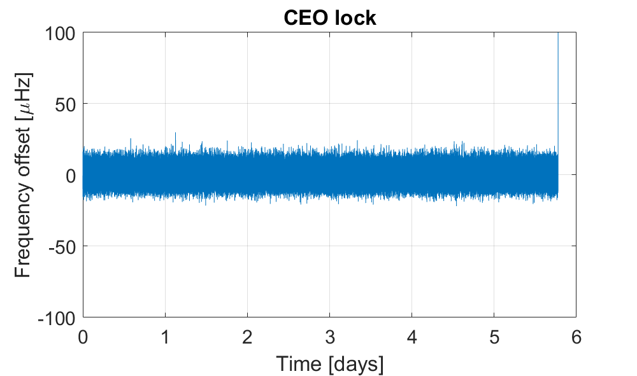
Frequency counter & lock - Example results – 5 days locked
ILX Amplifier pump driver: E511!
CEO lock on a fiber PM comb
In-loop count

Slide 20
Cycle slips: What’s a cycle slip?
Extra cycle!
Missing cycle!
In a traditional counter:
In the complex plane:
Im{}=Q
Im{}=Q
Im{}=Q
Re{}=I
Re{}=I
Re{}=I
Normal counting
Normal counting,
signal’s phase is 0
w/ noise
Cycle slip!

Slide 21
Cycle slips in complex plane
A cycle slip/unwrap error occurs when:
Noise vector > signal amplitude
Prob[Cycle slip] = Prob[Noise > Signal] = erf(SNR)
Im{}=Q
Black: Signal
Red: Noise
Re{}=I
Cycle slip!

Slide 22
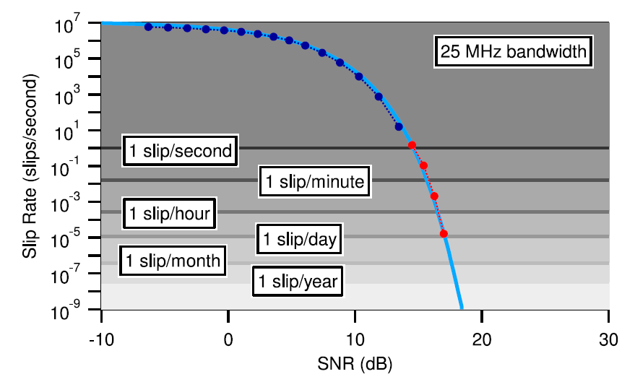
Cycle slips in DPLL
SNR is a critical parameter for rate of cycle slips
Ref: Sinclair, L. C. et al. "Invited Article: A compact optically coherent fiber frequency comb." Review of Scientific Instruments 86.8 (2015): 081301.

Slide 23
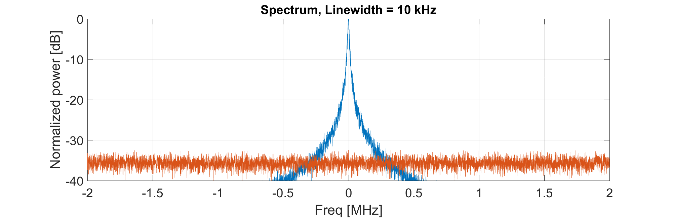
Optimizing SNR in DPLL
Want highest SNR for lowest prob cycle slip
How to choose filter BW in a DPLL?
SNR increases by decreasing BW
Converges to a limit value when BW < Linewidth
Assumptions:
10 kHz Lorenzian beat
Fixed noise level

Slide 24
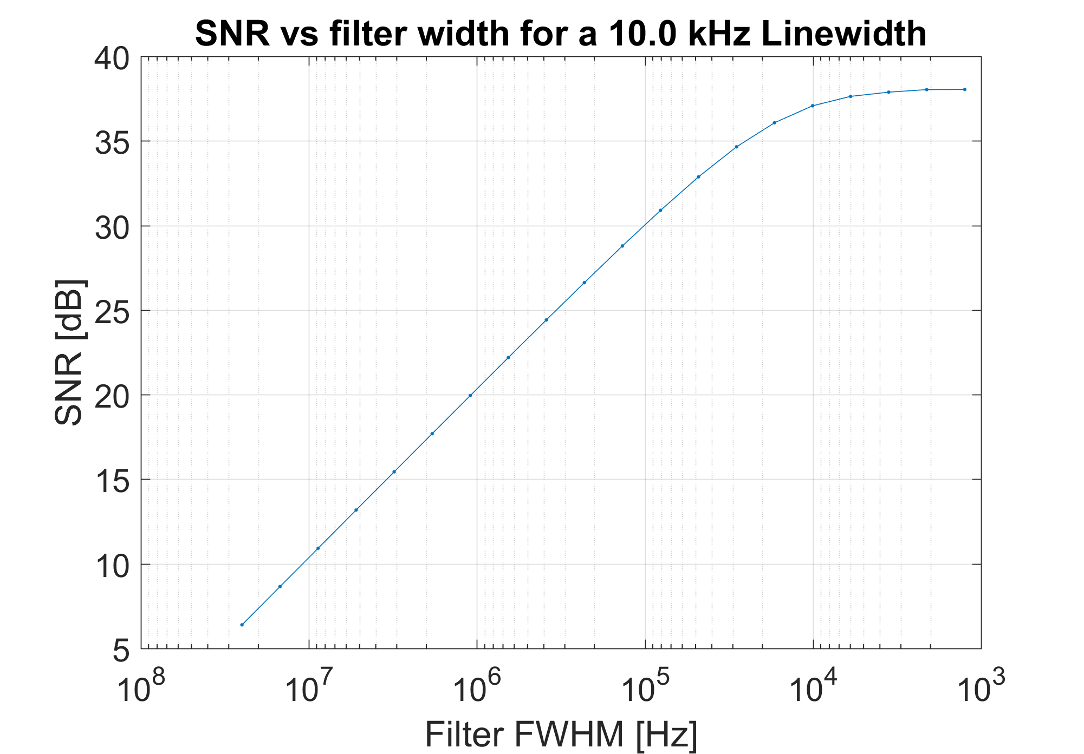
SNR limit at low BW
SNR converges to a maximum value
When BW < Linewidth
Reducing BW further removes as much signal as noise
Signal power
Linewidth = 10 kHz
Decreasing BW
Noise power

Slide 25
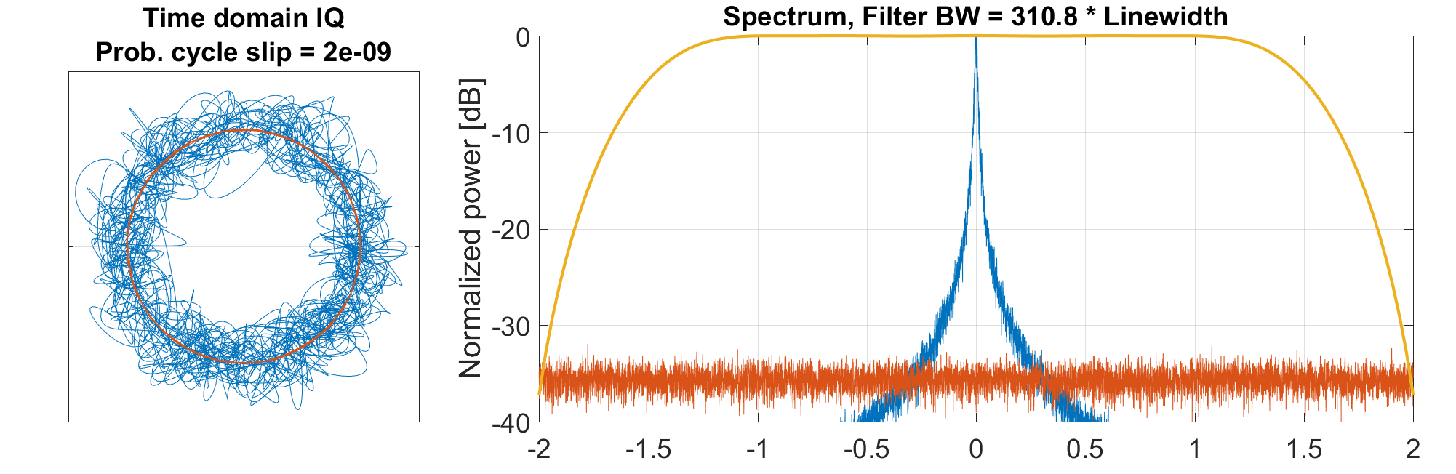
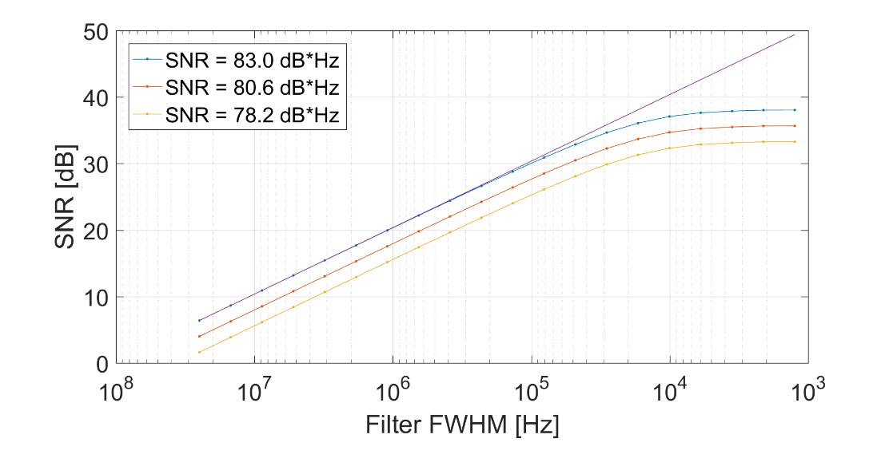
SNR=15dB
Right on the edge

Slide 26
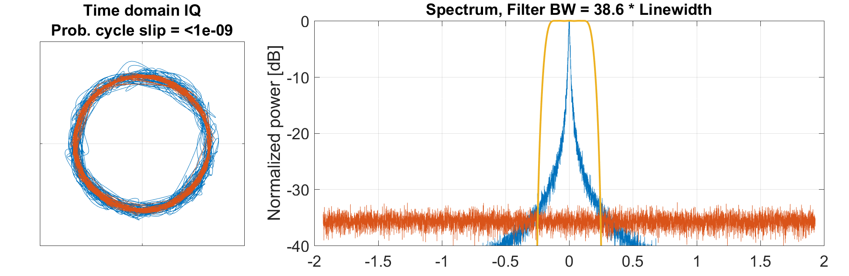
SNR=24dB
Ideal case

Slide 27
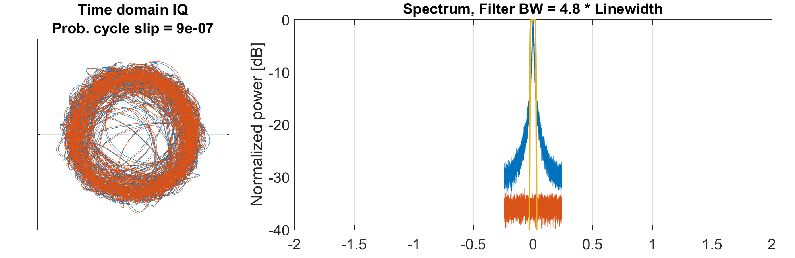
SNR=33dB
Barely any signal lost
But too much AM noise!

Slide 28
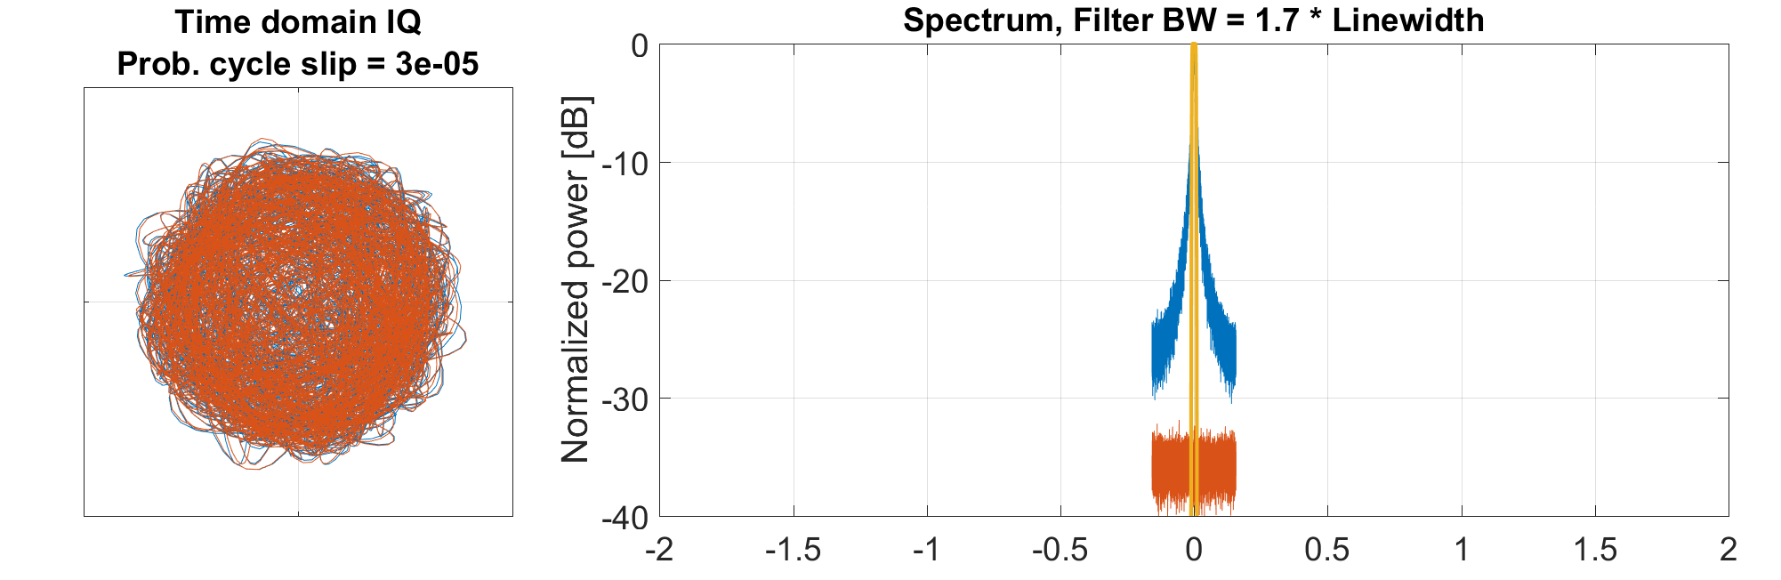
SNR=36dB
Lost only 2 dB of signal on average
But too much AM noise!
IQ eye completely closed

Slide 29
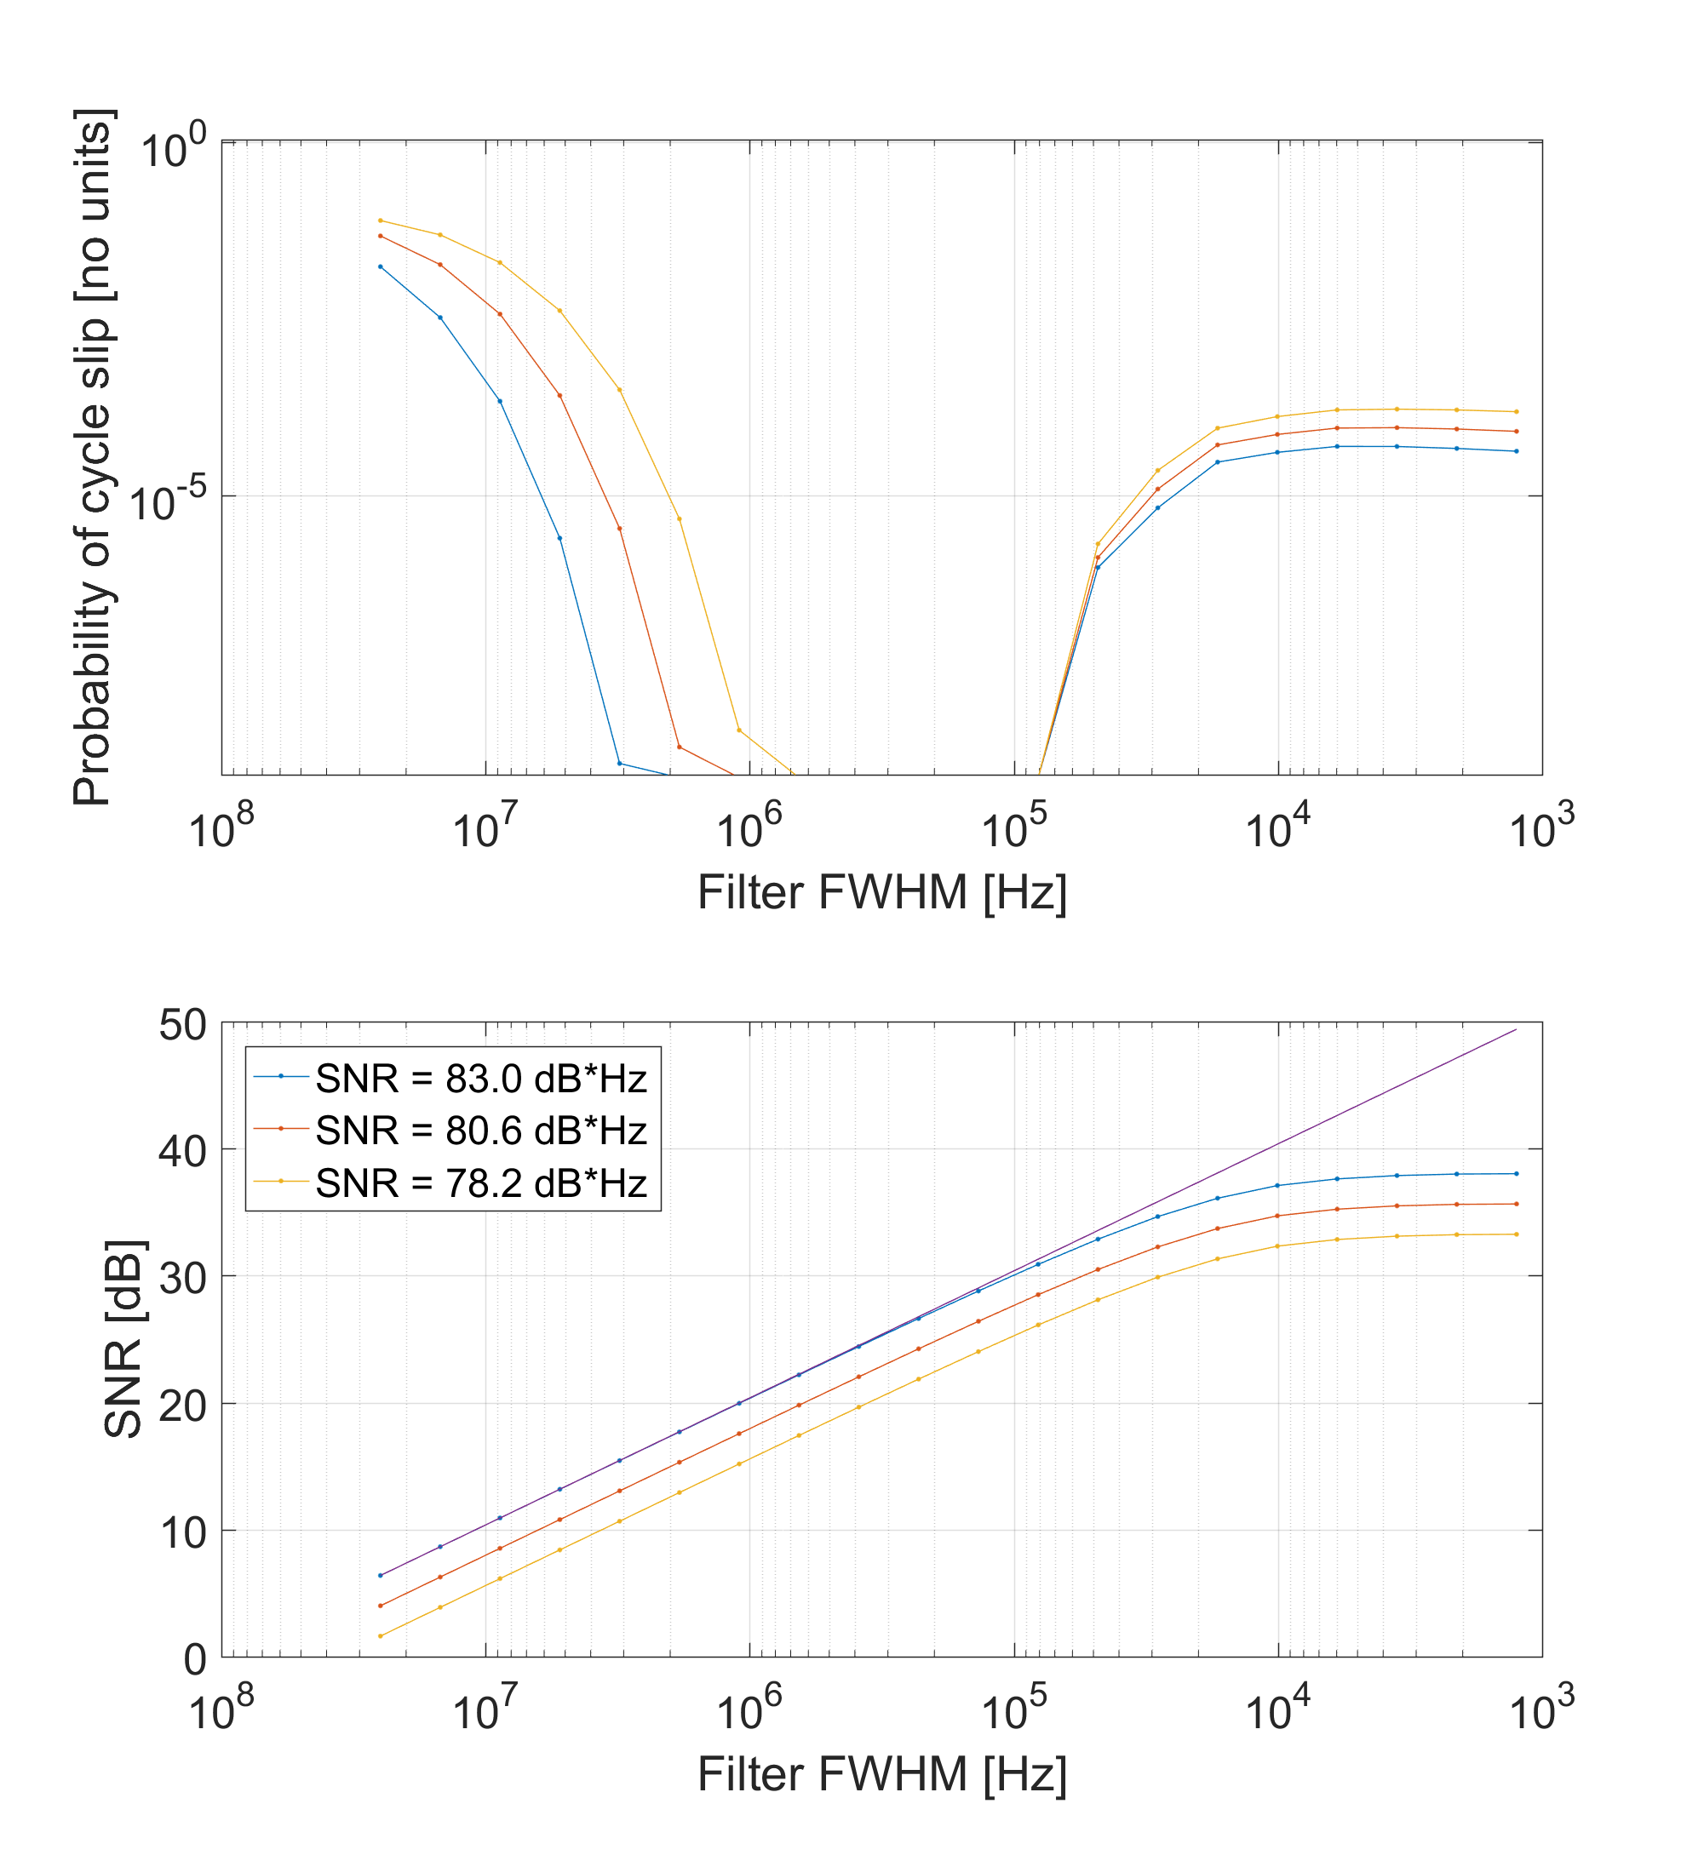
Probability of a cycle slip vs filter bandwidth
Desired operation zone
Linewidth = 10 kHz
Can barely tolerate any signal loss at all before slip probability becomes catastrophic
SNR does not capture this effect

Slide 30
Conclusion
Presented an open-source digital PLL for combs locking
Works on open-source hardware
Now also available on an affordable commercial board
You can run it in your lab for < 500$
Cycle slips
High SNR is required for low cycle slips
filter BW >> Linewidth (do not maximize SNR)

Slide 31


Thank you!
Funding:
Links
NIST digital lock box
https://www.nist.gov/services-resources/software/fpga-based-digital-control-box-phase-stabilization-frequency-comb
https://github.com/nist-ionstorage/digital-servo
jean-daniel.deschenes@gel.ulaval.ca

Slide 32
Extra slides

Slide 33
ADC noise
Largest signal:
2^N codes peak-peak,
2^N/(2*sqrt(2)) codes RMS
Quantization noise:
1/sqrt(12) codes RMS
SNR = 20*log10(2^N/(2*sqrt(2))*sqrt(12)) = N * 6 dB/bit + 1.76 dB

Slide 34
DAC noise
Ideal quantization noise is level as ADC (0.3 codes RMS), BUT
Noise appears after the loop filter: in-loop!
It gets rejected inside the lock BW as much as the laser noise
DAC model
Laser model
Quantizing noise
Laser
Freq noise
ADC
Demod
Loop filter
H_{laser}
If quantizing noise is << laser noise at any point, then it’s negligible
Quantizing noise * H_{laser} can be directly compared to the laser frequency noise

Slide 35
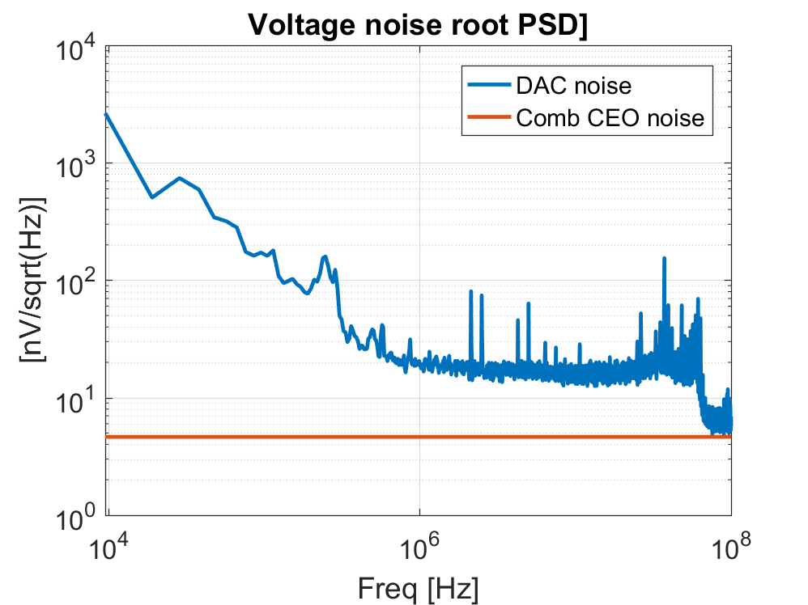
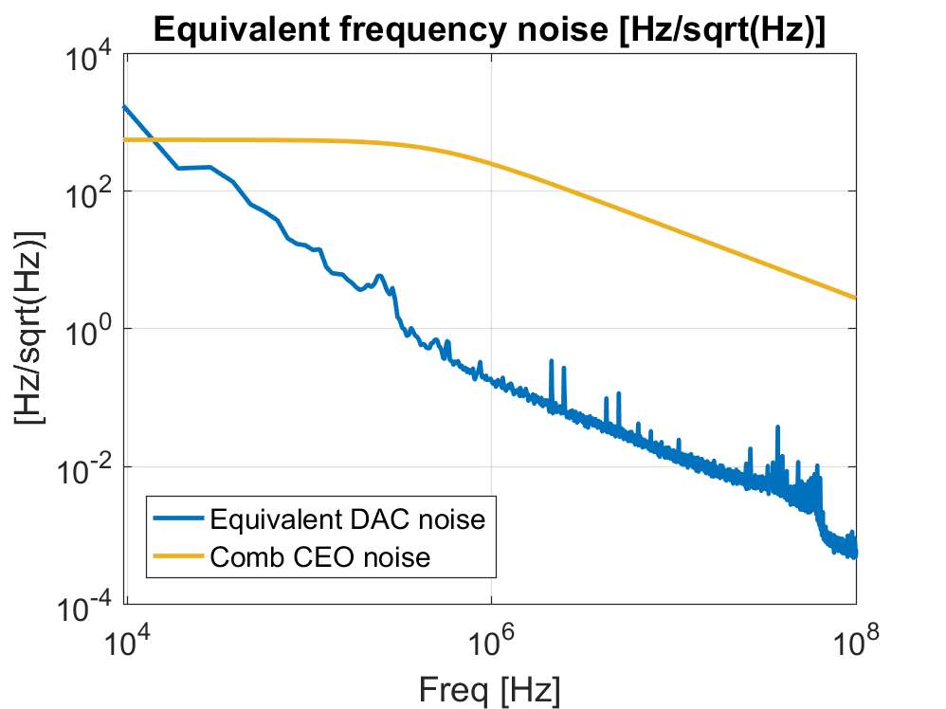
DAC noise: Red Pitaya
DAC Quantizing noise
DAC Quantizing noise
H_{laser}
In practice, DACs are usually closer to ‘ideal’ behavior
Red Pitaya’s output is within 11.5 dB of ideal 14-bits DAC
Experience shows that 14 bits is plenty…

Slide 36
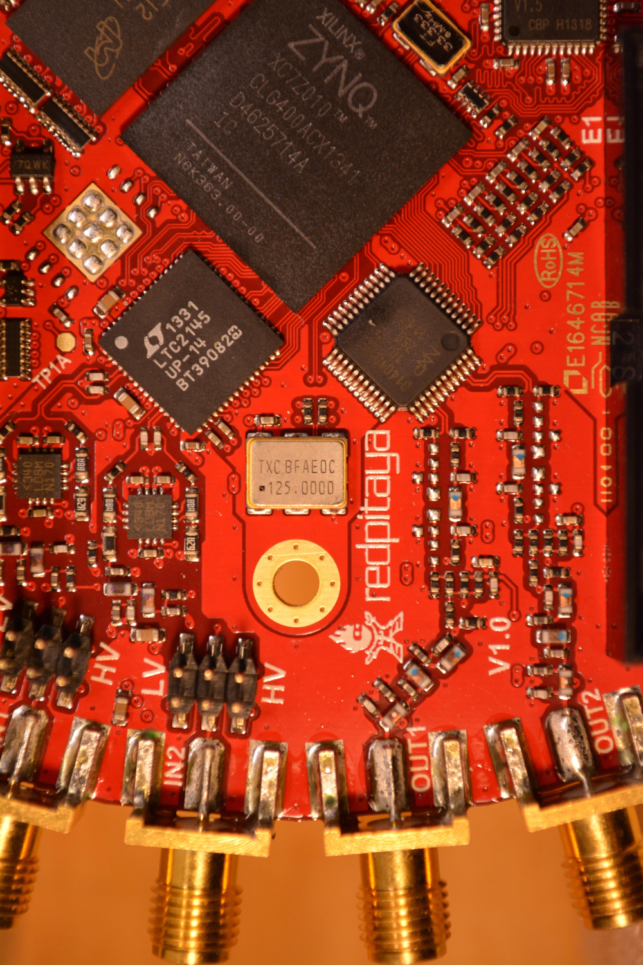
Red Pitaya’s on-board oscillator
125 MHz Quartz oscillator
Stability:
+/- 50 ppm stability (6 kHz) over Temp & aging
Phase jitter:
1 ps (12 kHz-20 MHz)
Can be bypassed through modification (untested)

Slide 37
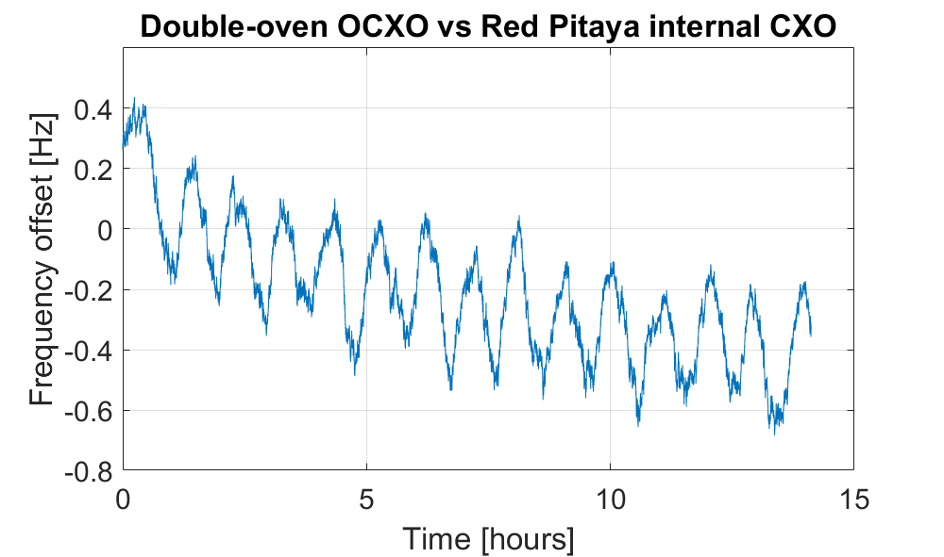
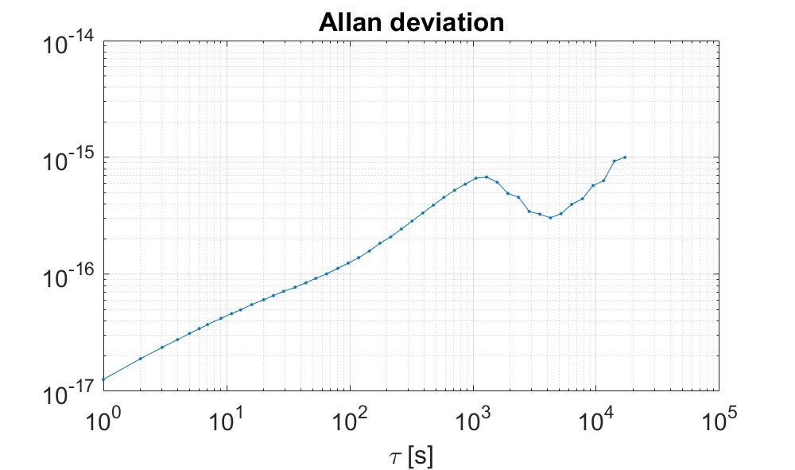
Actual stability is much better: < 2 Hz over 12 hours
In fairly stable laboratory conditions
Red Pitaya internal clock vs double-oven OCXO
<2 Hz

Slide 38
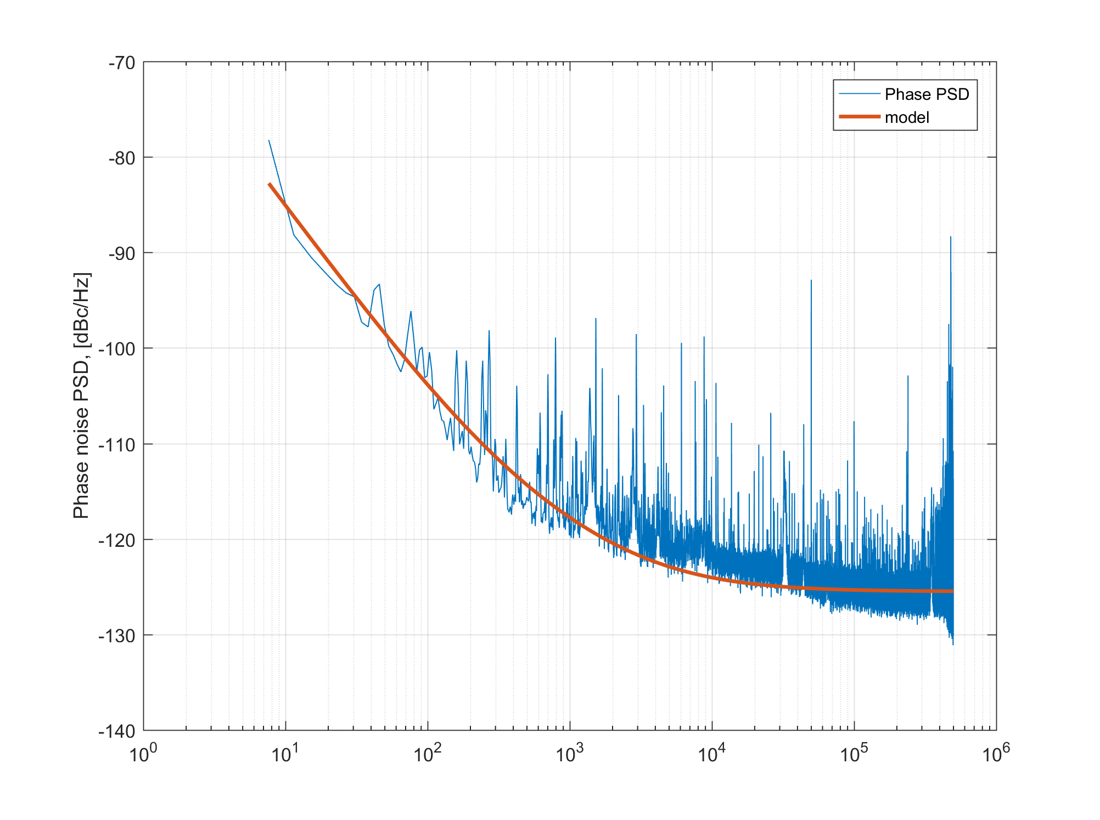
Actual measured phase noise
-70 dBc/Hz at f=1Hz
-125 dBc/Hz floor due to measurement limit
Phase noise PSD

Slide 39
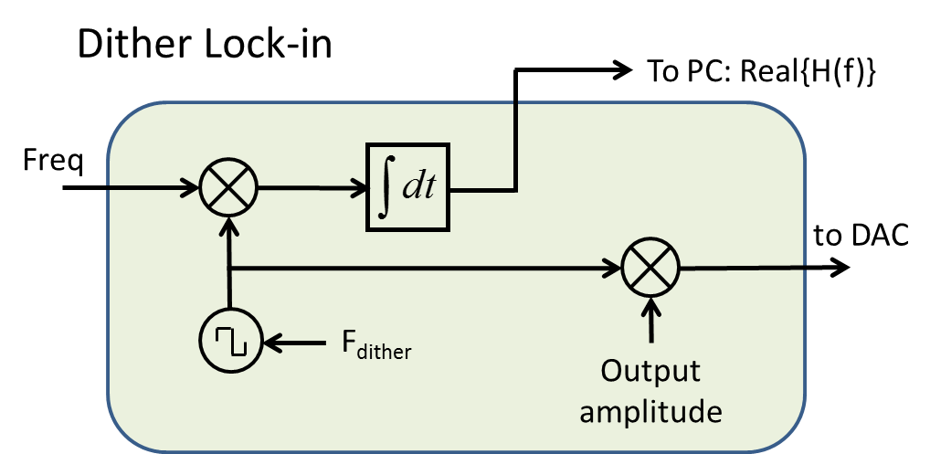
Feature: Dither lock-in
Gives continuous knowledge of loop sign & gain
Loop sign gives:
Guarantees stable lock
Garantees locking on right sideband
Loop gain gives:
Diagnostic of system health
Accurate loop BW design

Slide 40
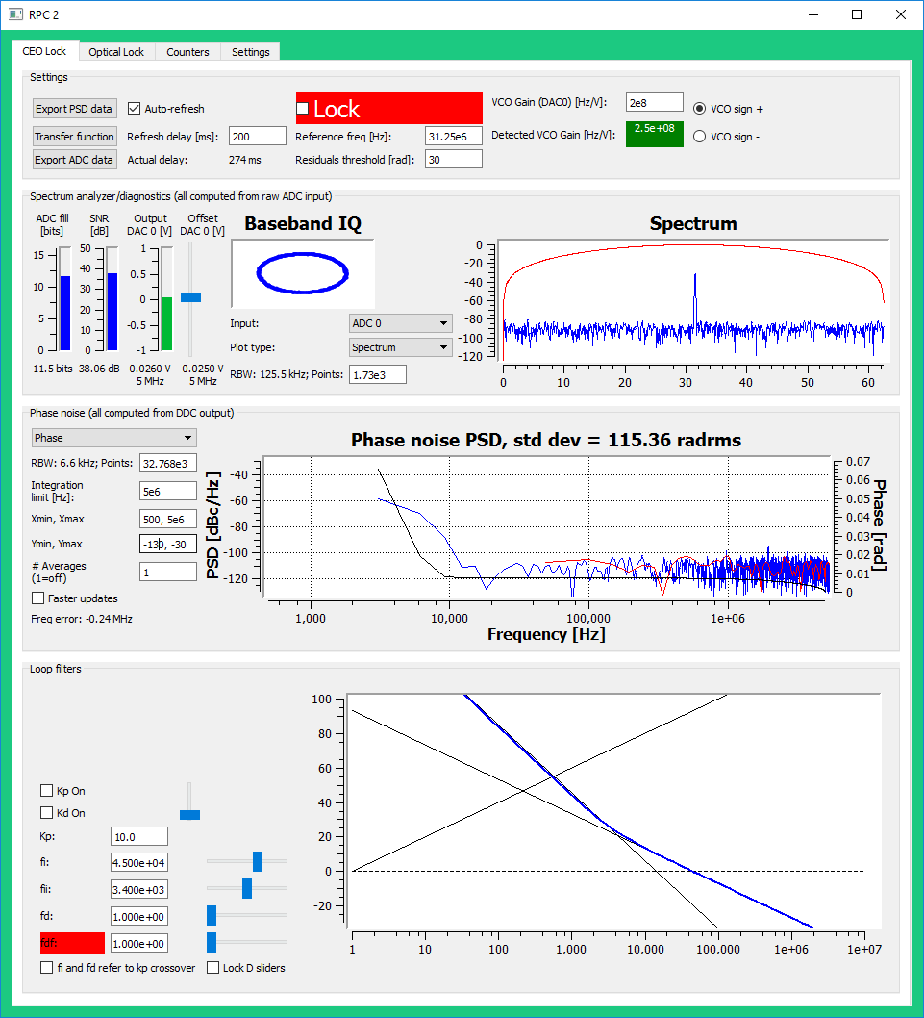
User Interface: Main window
Dither lock-in results
Access to VNA
Raw ADC data recording
RF Spectrum
Time domain display
IQ diagram
Phase noise Spectrum
Loop filter transfer function

Slide 41
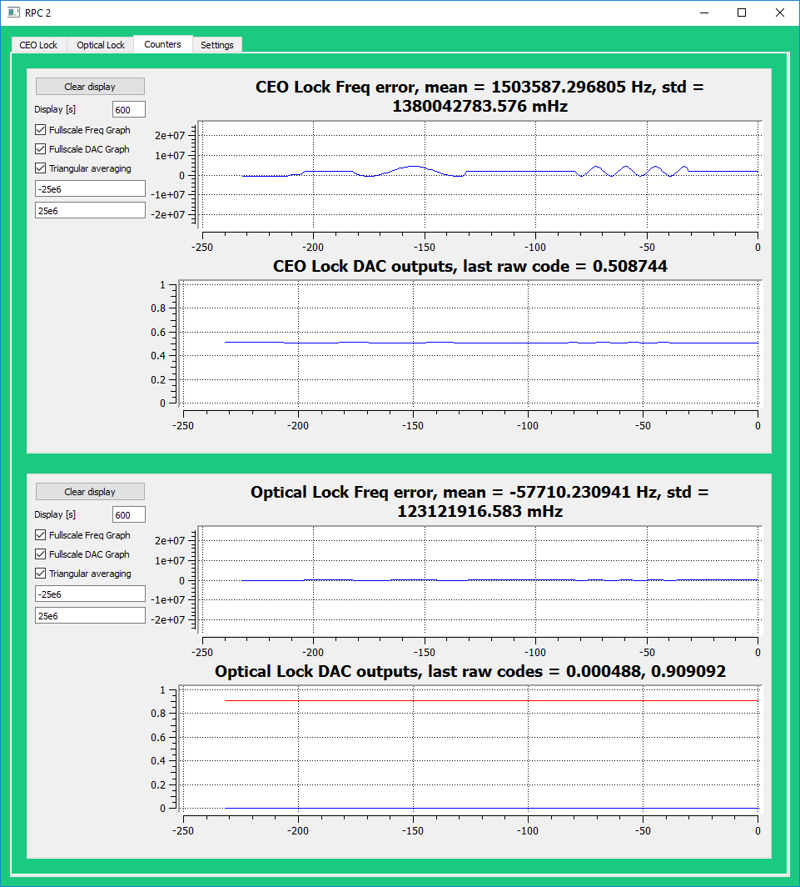
User interface: Frequency counters & output monitoring
Frequency counter
PLL Channel 1
Output monitoring
PLL Channel 2

Slide 42
Processing Latency
407 ns total latency
Max closed-loop BW:
1/(8T) ~ 300 kHz
407 ns
50 ns
207 ns
150 ns
FPGA
PLL Channel 1
ADC
Demod
Loop filter
DAC
Lockin
Freq counter

Slide 43
Feature: Vector Network Analyzer
VNA measures exactly the transfer function that matters
Exact same TF as seen by loop filter
Works open-loop or closed-loop!
Challenging to do with analog PLL
Laser
drive
Laser
FPGA
PLL Channel 1
D
LPF
ADC
Demod
Loop filter
DAC
Lockin
Freq counter
VNA

Slide 44
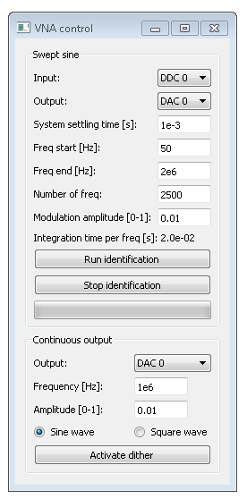
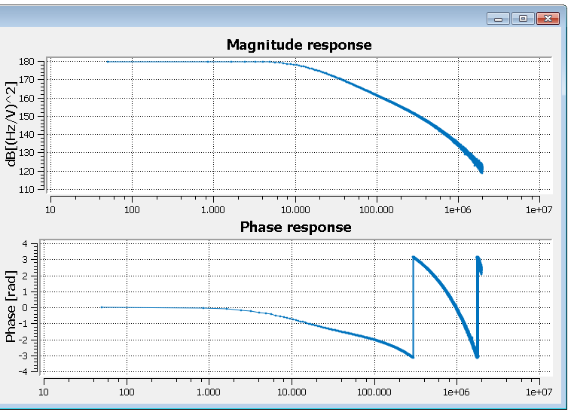
VNA Example results 1/2
CEO lock transfer function:
Current modulation of pump laser

Slide 45
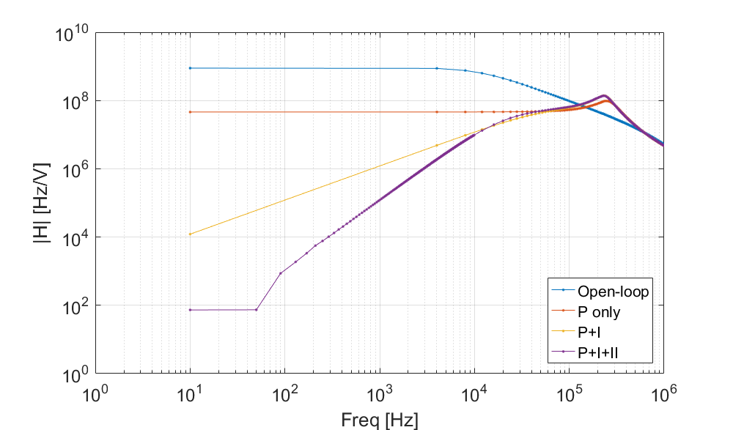
VNA Example results 2/2
CEO lock transfer function
Closed-loop measurements yields noise rejection transfer function
~140 dB dyn range limit

Slide 46
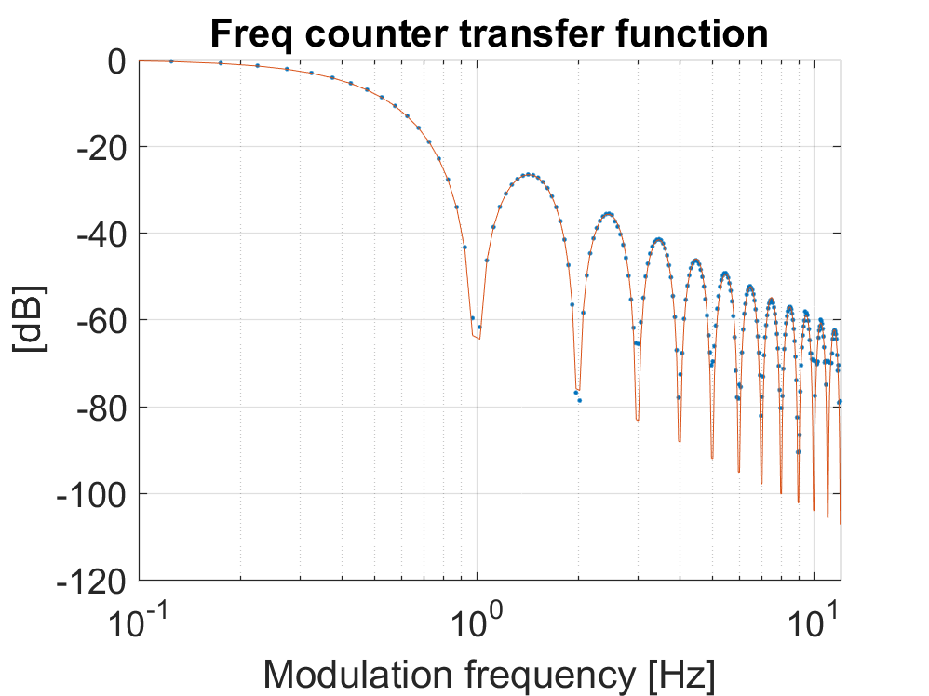
Feature: Frequency counter
Demodulator outputs frequency vs time...
Rectangular or Triangular type*
: sinc(fT) response
: sinc²(fT) response
T=1 sec nominal gate time
Zero dead-time
Transfer function validation experiment:
to PC
ADC
DDC
arctan
diff
counter
f₀+f_{m}
VCO
DAC
*Ref: Dawkins et al.: Measurement of Stability of Oscillators with Frequency Counters, IEEE Trans. Ultrasonics, Ferroelectrics and freq. control, vol 54, no 5, 2007

Slide 47
High-level block diagram (1 channel only)
FPGA
PLL Channel 1
ADC
Demod
Loop filter
DAC
Lockin
Freq counter
VNA

